Slide 1
Native Argtech
Panera Bread Broccoli Cheddar Soup 16 oz - Amazon.com and Walmart .com

Slide 2
Amazon.com
Some of the information I scraped from the website.
Total ratings: 550
Price: $4.47
Ingredients:Water, Milk, Broccoli, Cheddar Cheese ([Pasteurized Milk, Cheese Culture, Salt, Enzymes], Water, Sodium Phosphate, Milkfat, Salt, Apocarotenal [Color]), Heavy Cream, Carrots, Contains 2% or Less of: Seasoning (Modified Corn Starch, Flour [Wheat Flour, Ascorbic Acid Added as Dough Conditioner, Niacin, Reduced Iron, Thiamine Mononitrate, Riboflavin, Folic Acid], Salt, Spices, Extractives of Paprika), Onions, Chicken Base (Chicken Meat and Chicken Juices, Salt, Hydrolyzed Soy and Corn Protein, Sugar, Flavoring, Potato Flour, Autolyzed Yeast Extract, Carrot Powder and Turmeric), Butter (Cream, Salt), Modified Food Starch, Soybean Oil, Dijon Mustard (Water, Vinegar, Mustard Seed, Salt, White Wine, Fruit Pectin, Citric Acid, Tartaric Acid, Sugar, Spice), Nisin Preparation and Hot Pepper Sauce (Vinegar, Red Pepper, Salt).

Slide 3
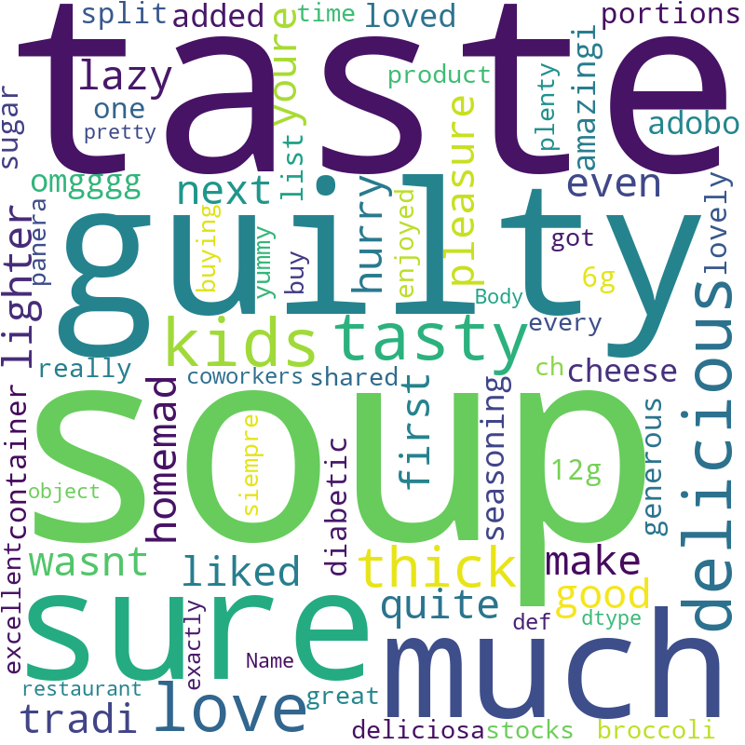
Positive comments - Wordcloud

Slide 4
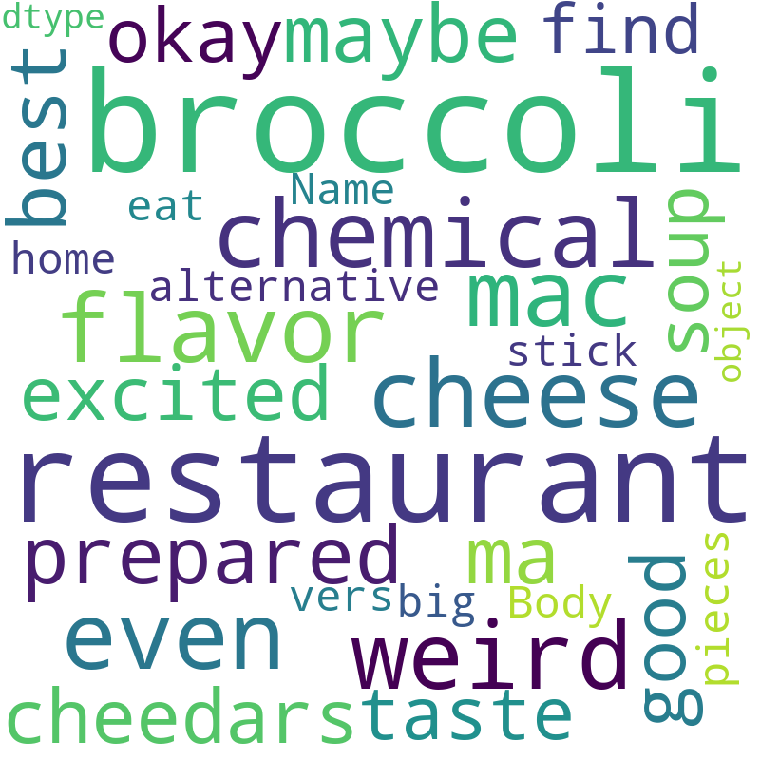
Critical comments - Wordcloud

